Slide 1
Comparisons Between Two Populations

Slide 2
Paired Observations

Slide 3
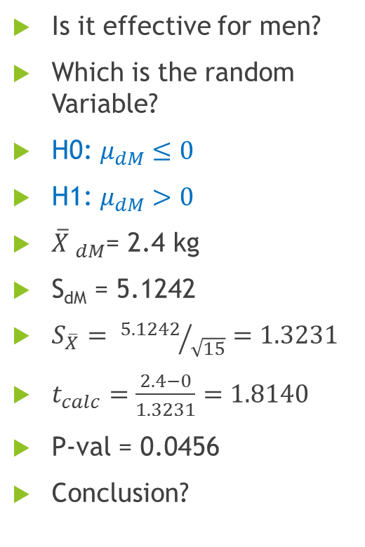
Chubby Chunky – 1 Matched Samples
Sl. No. | Before | After
1 | 72 | 68
2 | 84 | 78
3 | 83 | 75
4 | 96 | 92
5 | 78 | 86
6 | 83 | 79
7 | 102 | 95
8 | 74 | 72
9 | 82 | 81
10 | 80 | 87
11 | 88 | 83
12 | 76 | 74
13 | 79 | 72
14 | 70 | 75
15 | 91 | 85
Difference
4
6
8
4
-8
4
7
2
1
-7
5
2
7
-5
6
Is it effective for men?
Which is the random Variable?
H0: $μ_{dM}≤0$
H1: $μ_{dM}>0$
$\overline{X} _{dM}$= 2.4 kg
S_{dM} = 5.1242
$S_{\overline{X}}= {5.1242}/{\sqrt{15}}=1.3231$
$t_{calc}=\frac{2.4−0}{1.3231}=1.8140$
P-val = 0.0456
Conclusion?

Slide 4
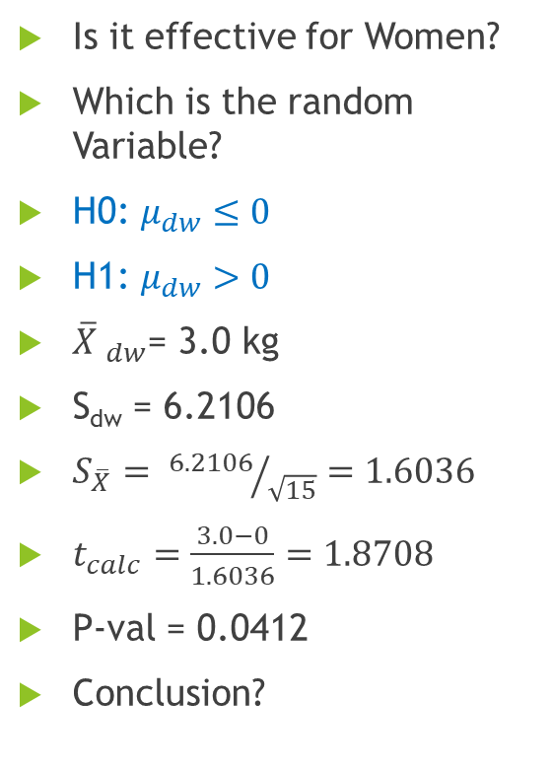
Chubby Chunky – 1 Matched Samples
Sl. No. | Before | After
1 | 98 | 92
2 | 89 | 84
3 | 76 | 65
4 | 84 | 77
5 | 87 | 95
6 | 93 | 88
7 | 90 | 84
8 | 79 | 76
9 | 81 | 77
10 | 68 | 77
11 | 74 | 70
12 | 70 | 66
13 | 103 | 94
14 | 72 | 80
15 | 79 | 73
Difference
6
5
11
7
-8
5
6
3
4
-9
4
4
9
-8
6
Is it effective for Women?
Which is the random Variable?
H0: $μ_{dw}≤0$
H1: $μ_{dw}>0$
$\overline{X} _{dw}$= 3.0 kg
S_{dw} = 6.2106
$S_{\overline{X}}= {6.2106}/{\sqrt{15}}=1.6036$
$t_{calc}=\frac{3.0−0}{1.6036}=1.8708$
P-val = 0.0412
Conclusion?

Slide 5
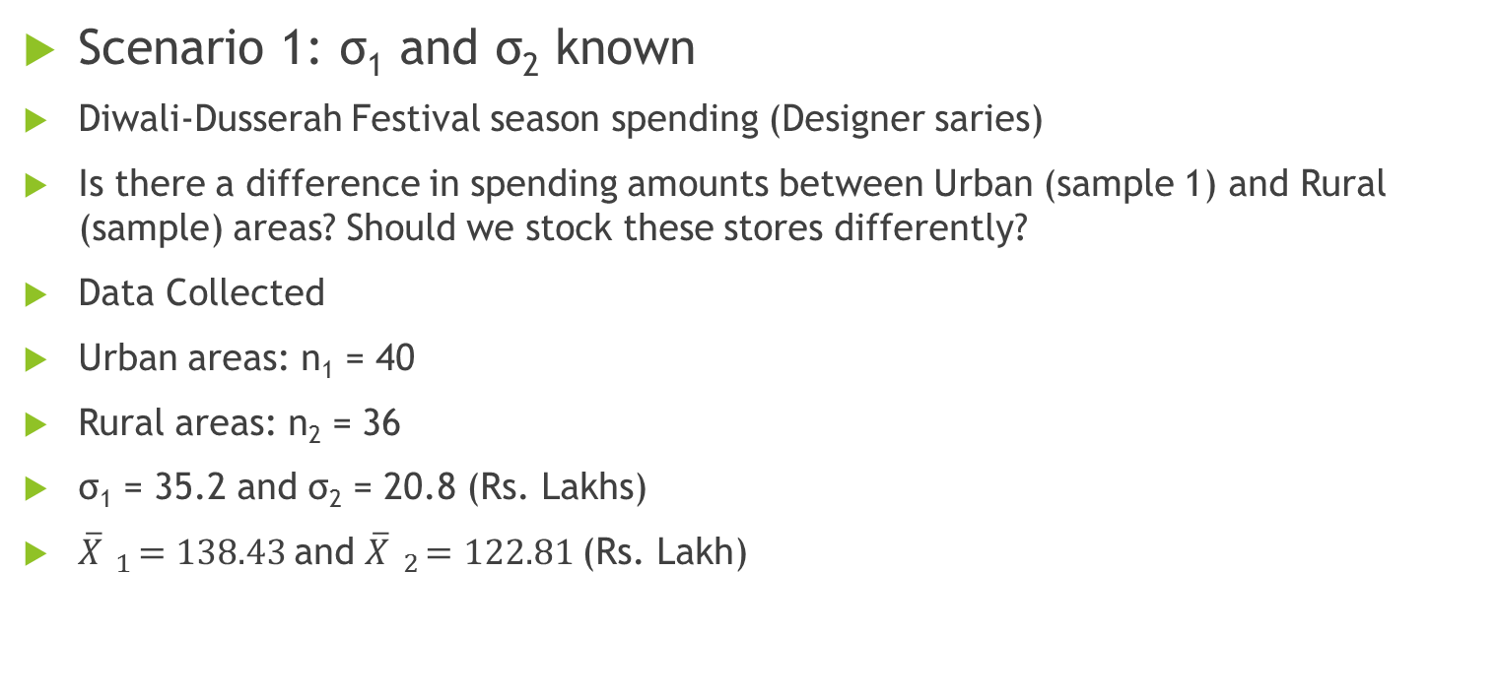
Difference between Two Population Means with Independent Samples
Scenario 1: σ₁ and σ₂ known
Diwali-Dusserah Festival season spending (Designer saries)
Is there a difference in spending amounts between Urban (sample 1) and Rural (sample) areas? Should we stock these stores differently?
Data Collected
Urban areas: n₁ = 40
Rural areas: n₂ = 36
σ₁ = 35.2 and σ₂ = 20.8 (Rs. Lakhs)
$\overline{X} _{1}=138.43$and $\overline{X} _{2}=122.81$(Rs. Lakh)

Slide 6
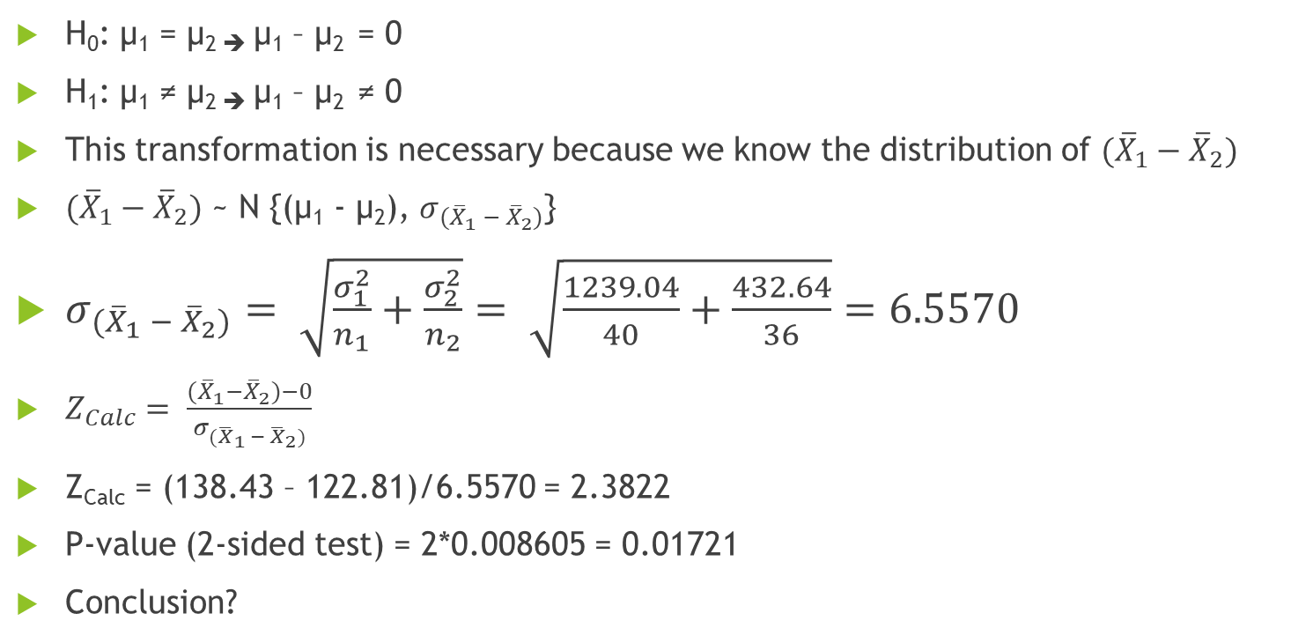
Hypothesis test
H₀: µ₁ = µ_{2 ➔} µ₁ – µ₂ = 0
H₁: µ₁ ≠ µ_{2 ➔} µ₁ – µ₂ ≠ 0
This transformation is necessary because we know the distribution of $({\overline{X}}_{1}−{\overline{X}}_{2})$
$({\overline{X}}_{1}−{\overline{X}}_{2})$ ~ N {(µ₁ - µ₂), $σ_{{(\overline{X}}_{1} − {\overline{X}}_{2})}$}
$σ_{{(\overline{X}}_{1} − {\overline{X}}_{2})}= \sqrt{\frac{σ_{1}^{2}}{n_{1}}+\frac{σ_{2}^{2}}{n_{2}}}= \sqrt{\frac{1239.04}{40}+\frac{432.64}{36}}=6.5570$
$Z_{Calc}= \frac{({\overline{X}}_{1}−{\overline{X}}_{2})−0}{σ_{{(\overline{X}}_{1} − {\overline{X}}_{2})}}$
Z_{Calc} = (138.43 – 122.81)/6.5570 = 2.3822
P-value (2-sided test) = 2*0.008605 = 0.01721
Conclusion?

Slide 7
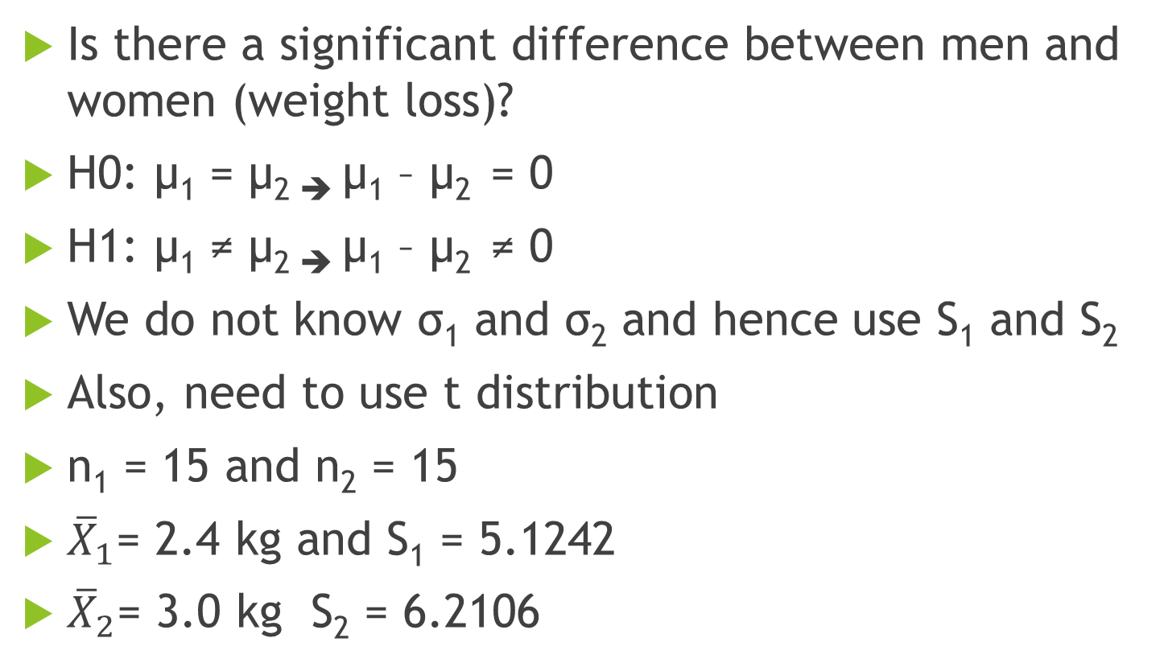
Chubby Chunky - 2
Is there a significant difference between men and women (weight loss)?
H0: µ₁ = µ_{2 ➔} µ₁ – µ₂ = 0
H1: µ₁ ≠ µ_{2 ➔} µ₁ – µ₂ ≠ 0
We do not know σ₁ and σ₂ and hence use S₁ and S₂
Also, need to use t distribution
n₁ = 15 and n₂ = 15
${\overline{X}}_{1}$= 2.4 kg and S₁ = 5.1242
${\overline{X}}_{2}$= 3.0 kg S₂ = 6.2106

Slide 8

Difference between Two Population Means with Independent Samples
Scenario 2: σ₁ and σ₂ NOT known
Two Possibilities:
σ₁ = σ₂ = σ
σ₁ ≠ σ₂
Consider the first one i.e., σ₁ = σ₂ = σ
$$S_{1}^{2}$$
$$S_{2}^{2}$$
σ²

Slide 9
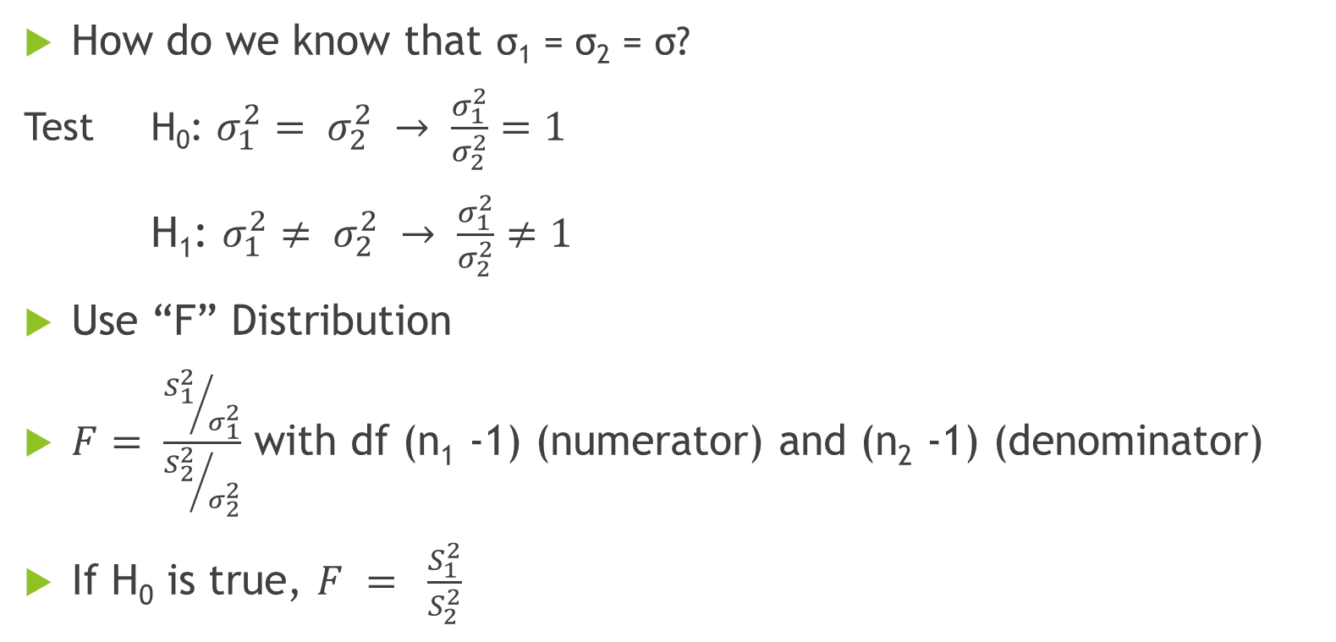
Test for Equality of Variances
How do we know that σ₁ = σ₂ = σ?
Test H₀: $σ_{1}^{2}= σ_{2}^{2} → \frac{σ_{1}^{2}}{σ_{2}^{2}}=1$
H₁: $σ_{1}^{2}≠ σ_{2}^{2} → \frac{σ_{1}^{2}}{σ_{2}^{2}}≠1$
Use “F” Distribution
$F= \frac{{S_{1}^{2}}/{σ_{1}^{2}}}{{S_{2}^{2}}/{σ_{2}^{2}}}$ with df (n₁ -1) (numerator) and (n₂ -1) (denominator)
If H₀ is true, $F = \frac{S_{1}^{2}}{S_{2}^{2}}$

Slide 10
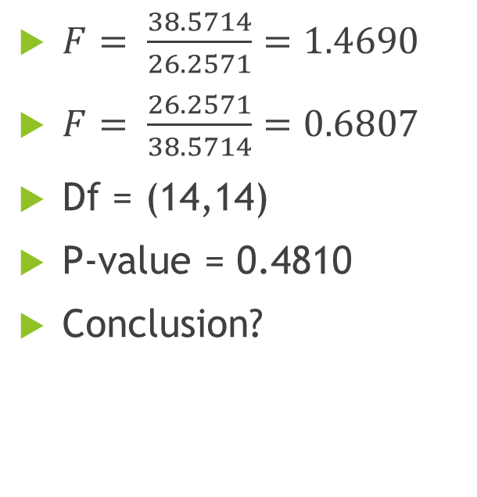
The F Test
$F= \frac{38.5714}{26.2571}=1.4690$
$F= \frac{26.2571}{38.5714}=0.6807$
Df = (14,14)
P-value = 0.4810
Conclusion?
0.2405
0.2405
0.6807
1.4690

Slide 11
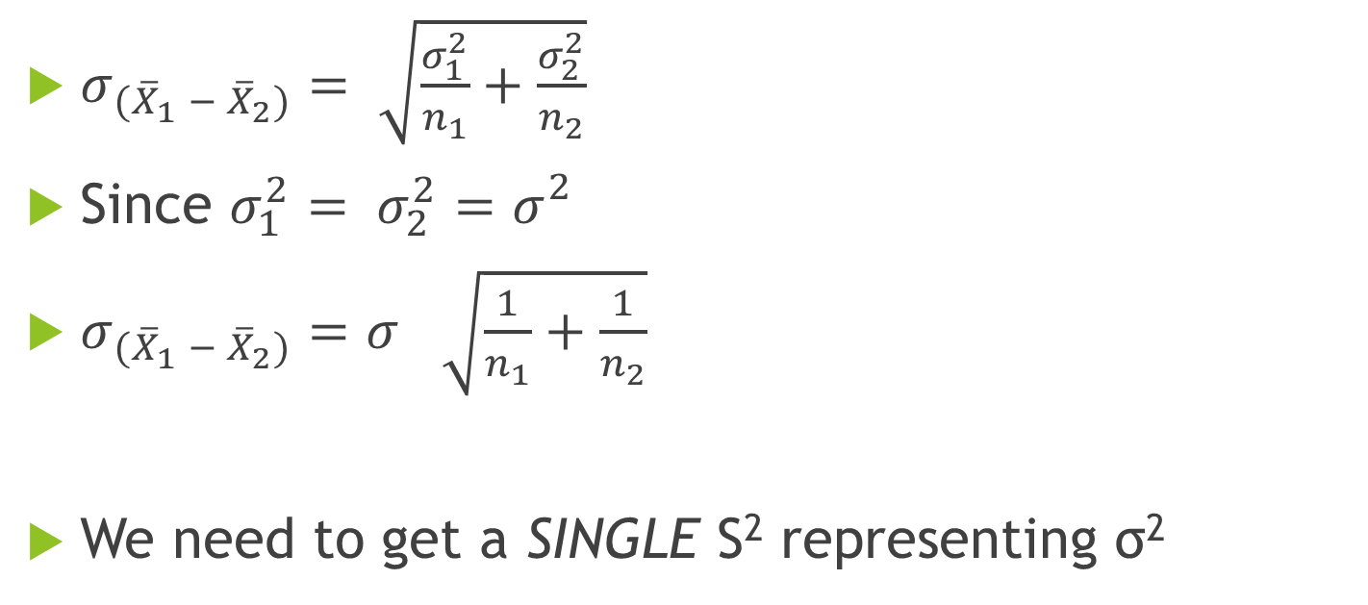
Standard Error
$σ_{{(\overline{X}}_{1} − {\overline{X}}_{2})}= \sqrt{\frac{σ_{1}^{2}}{n_{1}}+\frac{σ_{2}^{2}}{n_{2}}}$
Since $σ_{1}^{2}= σ_{2}^{2}=σ_{}^{2}$
$σ_{{(\overline{X}}_{1} − {\overline{X}}_{2})}=σ_{ }^{}\sqrt{\frac{1}{n_{1}}+\frac{1}{n_{2}}}$
We need to get a SINGLE S² representing σ²

Slide 12
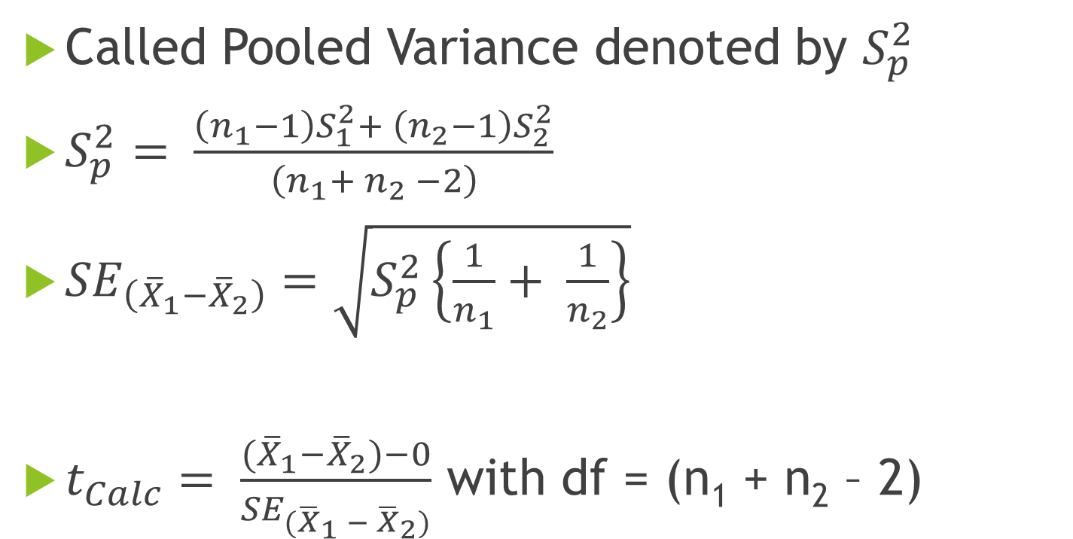
Combine the Two Sample Variances!
Called Pooled Variance denoted by $S_{p}^{2}$
$S_{p}^{2}= \frac{\left(n_{1}−1\right)S_{1}^{2}+ \left(n_{2}−1\right)S_{2}^{2}}{\left(n_{1}+ n_{2} −2\right)}$
${SE}_{\left({\overline{X}}_{1}−{\overline{X}}_{2}\right)}=\sqrt{S_{p}^{2}\left\{\frac{1}{n_{1}}+ \frac{1}{n_{2}}\right\}}$
$t_{Calc}= \frac{({\overline{X}}_{1}−{\overline{X}}_{2})−0}{{SE}_{{(\overline{X}}_{1} − {\overline{X}}_{2})}}$ with df = (n₁ + n₂ – 2)

Slide 13
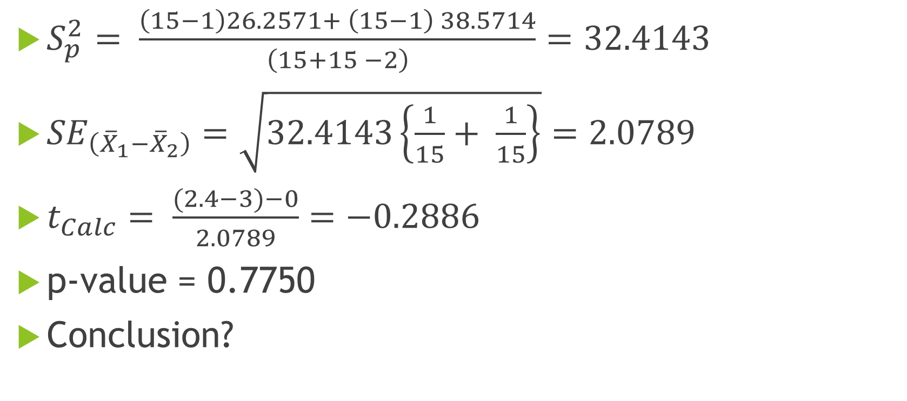
Hypothesis Test
$S_{p}^{2}= \frac{\left(15−1\right)26.2571+ \left(15−1\right) 38.5714}{\left(15+15 −2\right)}=32.4143$
${SE}_{\left({\overline{X}}_{1}−{\overline{X}}_{2}\right)}=\sqrt{32.4143\left\{\frac{1}{15}+ \frac{1}{15}\right\}}=2.0789$
$t_{Calc}= \frac{(2.4−3)−0}{2.0789}=−0.2886$
p-value = 0.7750
Conclusion?

Slide 14
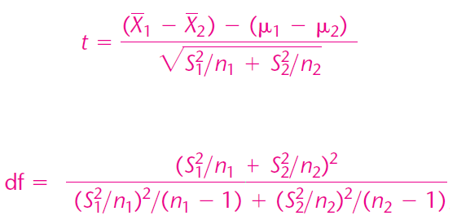
One More Scenario
σ₁ and σ₂ NOT known
And σ₁ ≠ σ₂

Slide 15
The Seven Point Advantage?
72 percent of our customers come back to ICL for repurchase
whereas only 65 percent of NSIS go back to NSIS for repurchases.
That is a full SEVEN percentage points more!

Slide 16
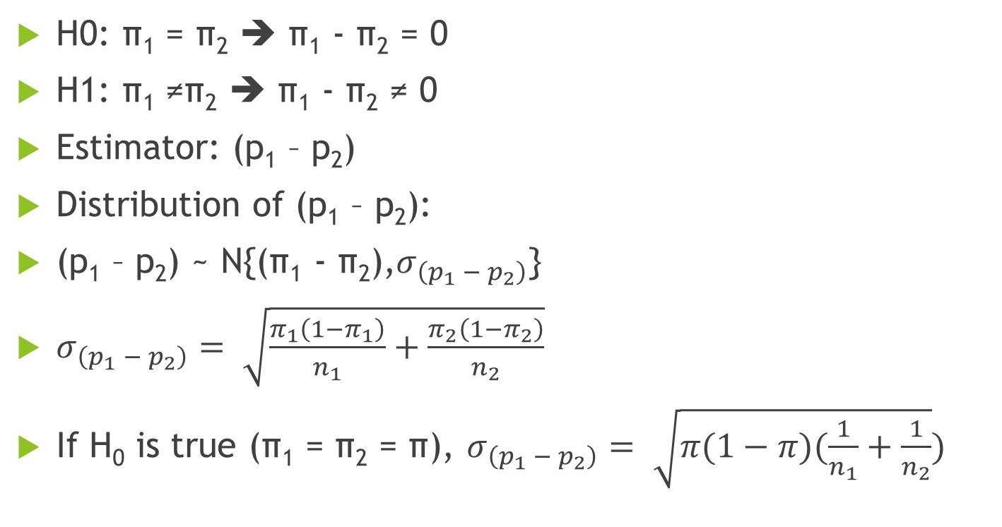
Hypothesis Test
H0: π₁ = π₂ ➔ π₁ - π₂ = 0
H1: π₁ ≠π₂ ➔ π₁ - π₂ ≠ 0
Estimator: (p₁ – p₂)
Distribution of (p₁ – p₂):
(p₁ – p₂) ~ N{(π₁ - π₂),$σ_{\left(p_{1} − p_{2}\right)}$}
$σ_{\left(p_{1} − p_{2}\right)}= \sqrt{\frac{π_{1}\left(1−π_{1}\right)}{n_{1}}+\frac{π_{2}\left(1−π_{2}\right)}{n_{2}}}$
If H₀ is true (π₁ = π₂ = π), $σ_{\left(p_{1} − p_{2}\right)}= \sqrt{π(1−π)(\frac{1}{n_{1}}+\frac{1}{n_{2}}})$

Slide 17
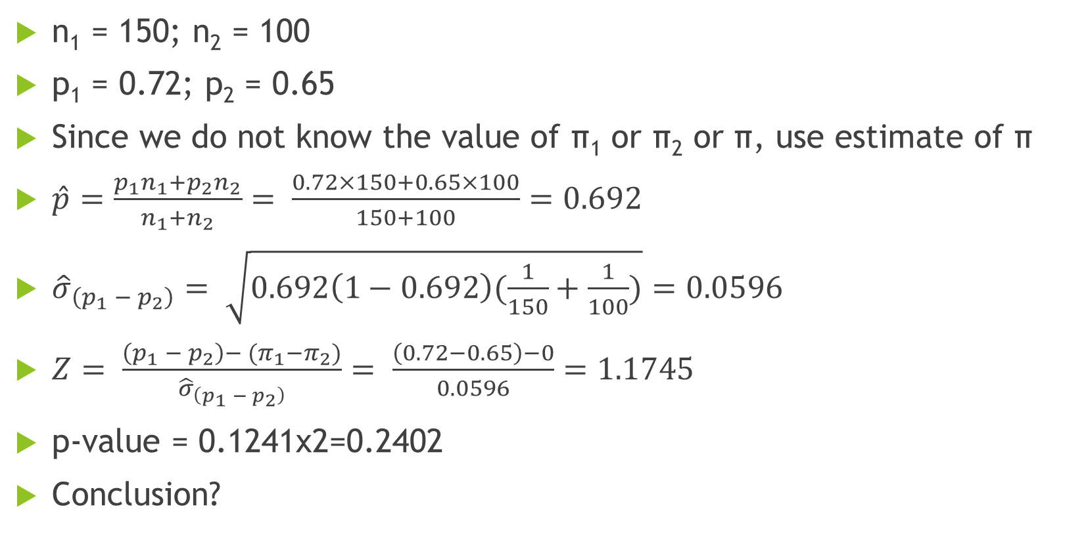
Basic Data
n₁ = 150; n₂ = 100
p₁ = 0.72; p₂ = 0.65
Since we do not know the value of π₁ or π₂ or π, use estimate of π
$\hat{p}=\frac{p_{1}n_{1}+p_{2}n_{2}}{n_{1}+n_{2}}= \frac{0.72×150+0.65×100}{150+100}=0.692$
${\hat{σ}}_{\left(p_{1} − p_{2}\right)}= \sqrt{0.692\left(1−0.692\right)(\frac{1}{150}+\frac{1}{100})}=0.0596$
$Z= \frac{\left(p_{1} − p_{2}\right)−{ (π}_{1}−π_{2})}{{\hat{σ}}_{\left(p_{1} − p_{2}\right)}}= \frac{\left(0.72−0.65\right)−0}{0.0596}=1.1745$
p-value = 0.1241x2=0.2402
Conclusion?

Slide 18
Questions?

